Slide 1
Capstone Project - 4
Netflix Movies and TV Shows Clustering
Unsupervised Machine Learning
Kanika Raj

Slide 2
Table Of Contents
Defining problem statement
Data Cleaning & visualization
Data Preprocessing
Feature Selection
Applying different clustering methods
Applying Clustering Models
Conclusion

Slide 3

Problem Statement
This dataset consists of tv shows and movies available on Netﬂix as of 2019. The dataset is collected from Flixable which is a third-party Netﬂix search engine.
In 2018, they released an interesting report which shows that the number of TV shows on Netﬂix has nearly tripled since 2010. The streaming service’s number of movies has decreased by more than 2,000 titles since 2010, while its number of TV shows has nearly tripled. It will be interesting to explore what all other insights can be obtained from the same dataset.

Slide 4
Data Summary
show_id : Unique ID for every Movie / Tv Show
type : A Movie or TV Show
title : Title of the Movie / Tv Show
director : Director of the Movie
cast : Actors involved in the movie / show
country : Country where the movie / show was produced
date_added : Date it was added on Netﬂix
release_year : Actual Release year of the movie / show
rating : TV Rating of the movie / show
duration : Total Duration - in minutes or number of seasons
listed in : Genre's
description: The Summary description

Slide 5
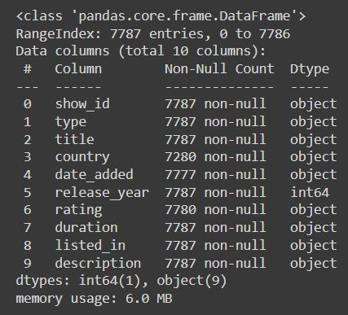
Basic Data Exploration
The dataset has 7787 observations and 12 features(columns).
The dataset consists of eleven textual columns and one numeric column(‘release_year’ )
No Duplicate values.

Slide 6
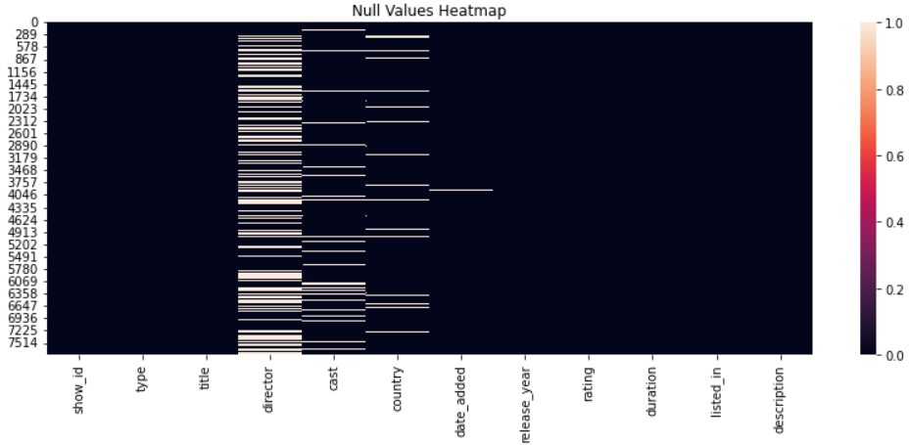
EDA (Checking NaN values)
Null values present in this columns
director
cast
country
Rating
No missing value present in this columns
show_id
type
title
date_added
release_year
duration
listed_in
description

Slide 7
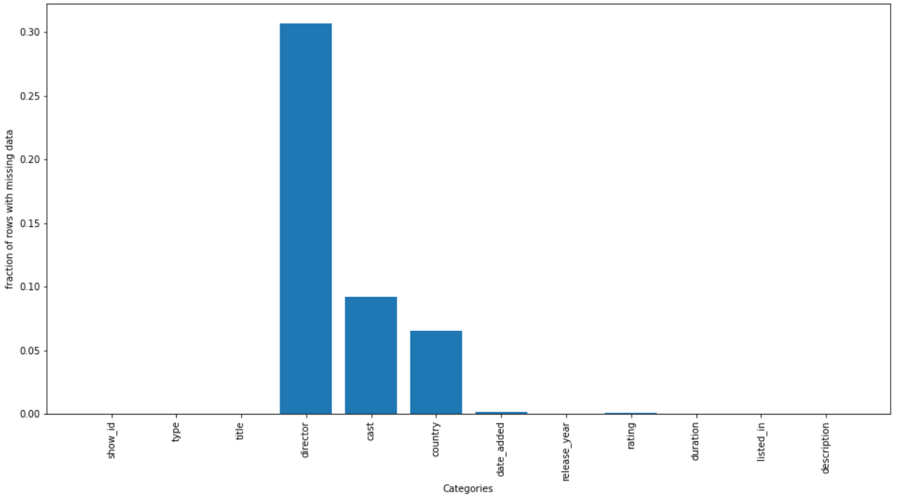
Distribution of NaN values in this dataset
So from above bar graph its clear that director and cast contains large number of null values followed by country and date_added.

Slide 8
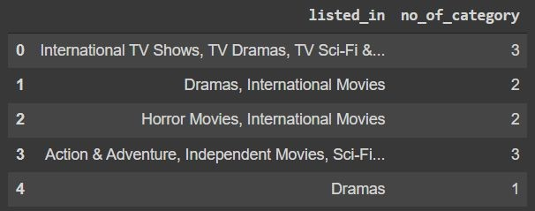
Data Cleaning
Removing unnecessary columns like 'director','cast'
Dropping all the NaN containing date_added observations(Only 10 observations was there )
Created 4 new columns:
No_of_categories based on listed_in
Date_added_month based on date_added

Slide 9
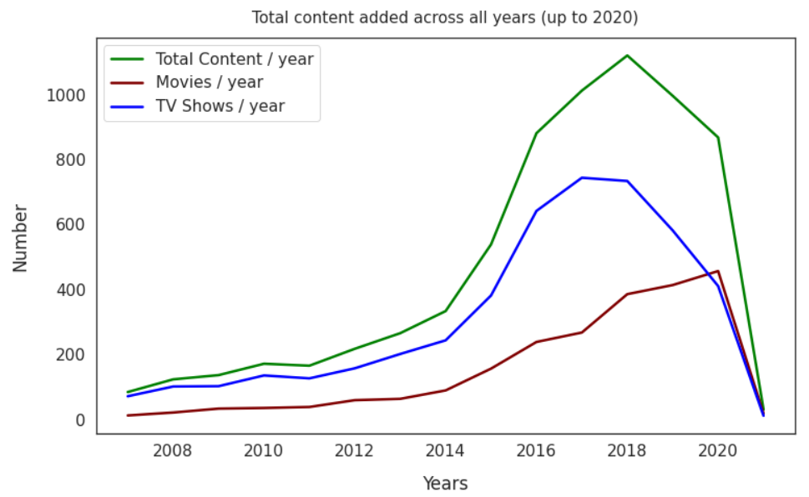
Production Yearly Growth
Based on the timeline above, we can conclude that the popular streaming platform started gaining traction after
2013. Since then, the amount of content added has been increasing significantly.
The growth in the number movies on Netflix much higher than that on TV shows. About 1,300 new movies were added in both 2018 and 2019. Besides we know that Netflix has increasingly focused on movies rather than Tv shows in recent years.

Slide 10
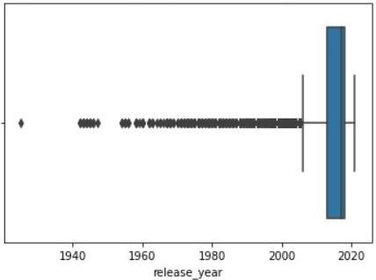
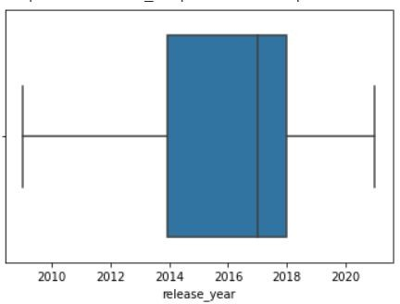
Checking and treating Outliers.
The above box plot shows that the outliers in the column ‘release_year’. Which is treated by replacing them with their mean values.

Slide 11
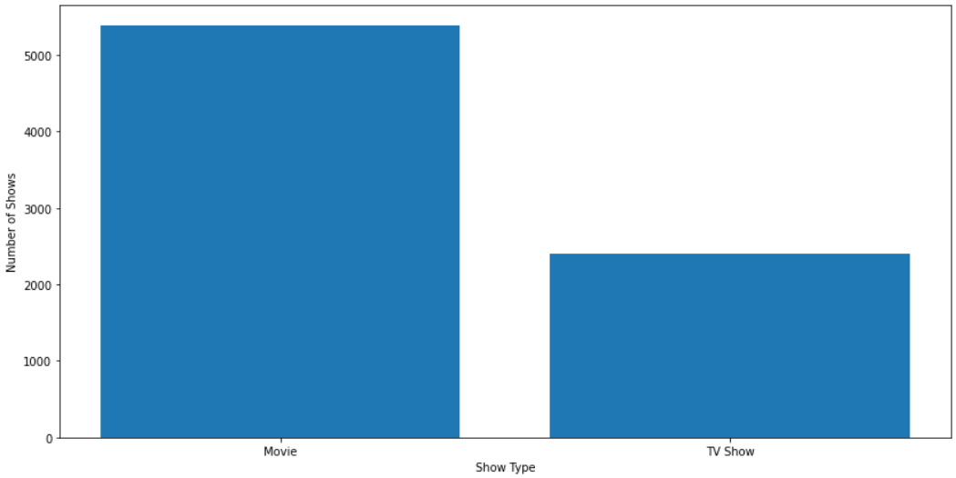
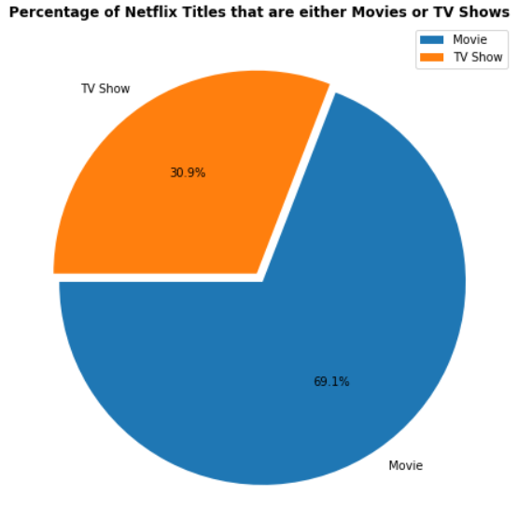
Type of shows with visualisation
So there are roughly 5,000+ movies and approx. 3,000 Tv shows with movies being the majority. This makes sense since shows are always an ongoing thing and have episodes. If we were to do a headcount of TV show episodes vs. movies, I am sure that TV shows would come out as the majority. However, in terms of title, there are far more movie titles (69.1%) than TV show titles (30.9%).

Slide 12
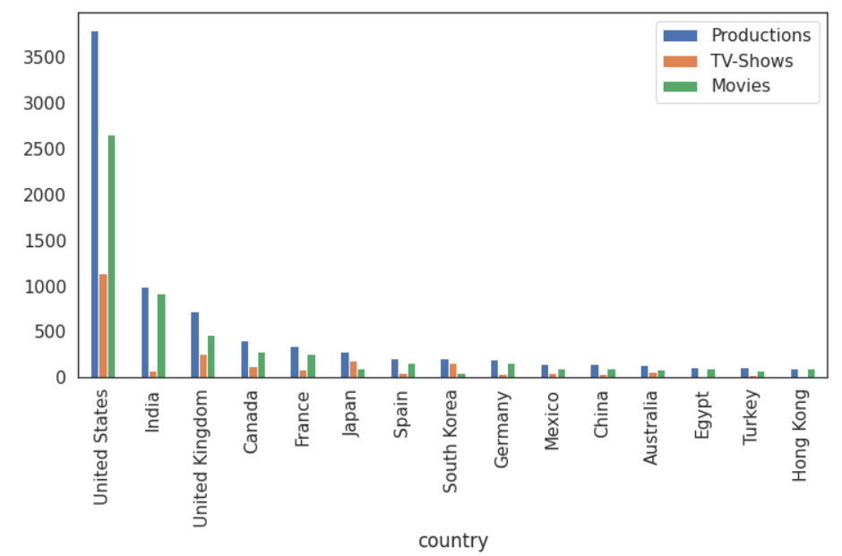
Countries producing most number of contents
United states have the most number of content then India and so on
We can conclude that except Japan other countries are producing movies more than TV-Shows.

Slide 13
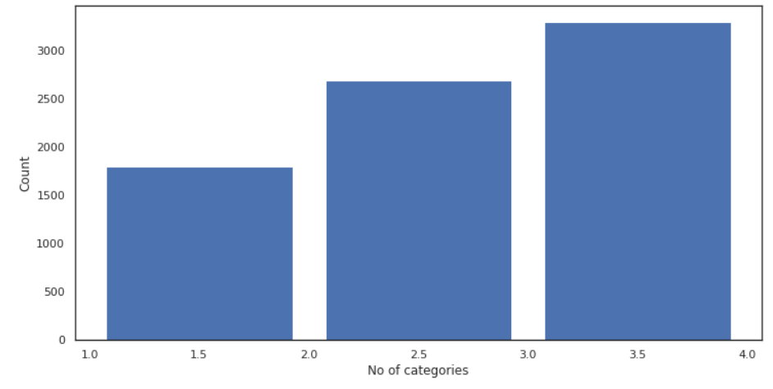
Categories present in each content
So from above Histogram graph we can see that there are 3 unique categories of contents with their count values and we bin the values for better clarity, like there are International TV Shows', ' TV Dramas', ' TV Sci-Fi & Fantasy contents so we bin their count values for better visualization.
Most of the movies are belonging to category three.

Slide 14
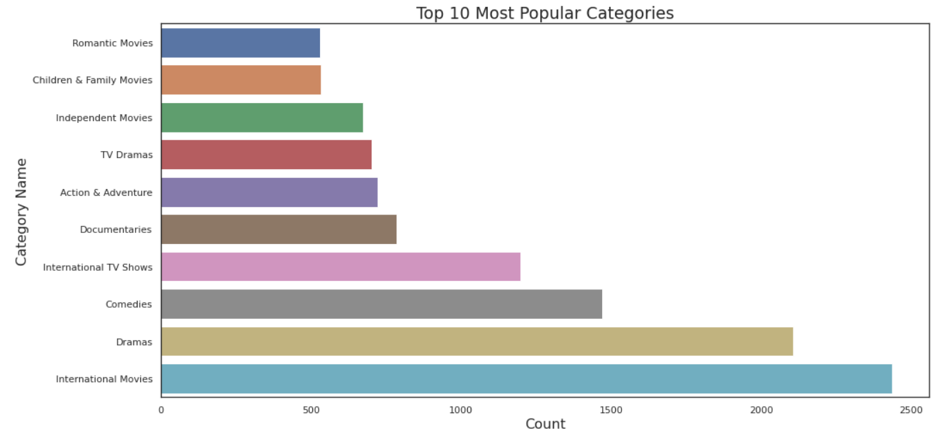
Top 10 Category For Contents
The above graph shows that the most popular categories are international movies, dramas, comedies while on the other hand romantic and family movies are less popular.

Slide 15
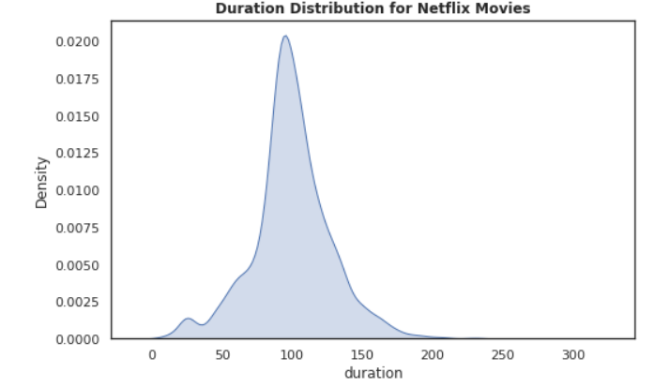
Density plot for movies
Above density plot, we can see that the duration for Netflix movies closely resembles a normal distribution with the average viewing time spanning about 90 minutes.
Most movies are about 70 to 120 min duration for movies

Slide 16
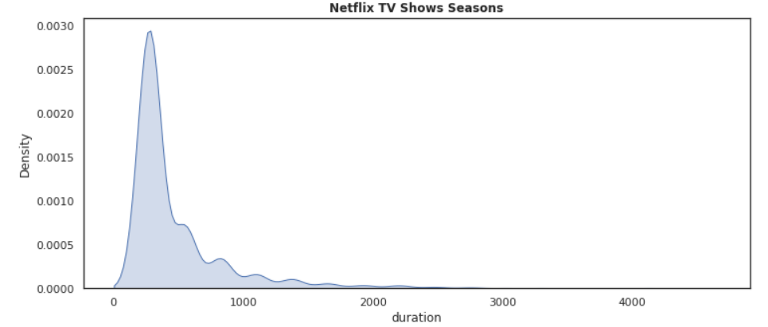
Density plot for TV shows
Most contents are about 0 to 750 min duration for movies.
There are very few shows which is having more than 1000 mins. (may be the no of episodes/ seasons are more)

Slide 17
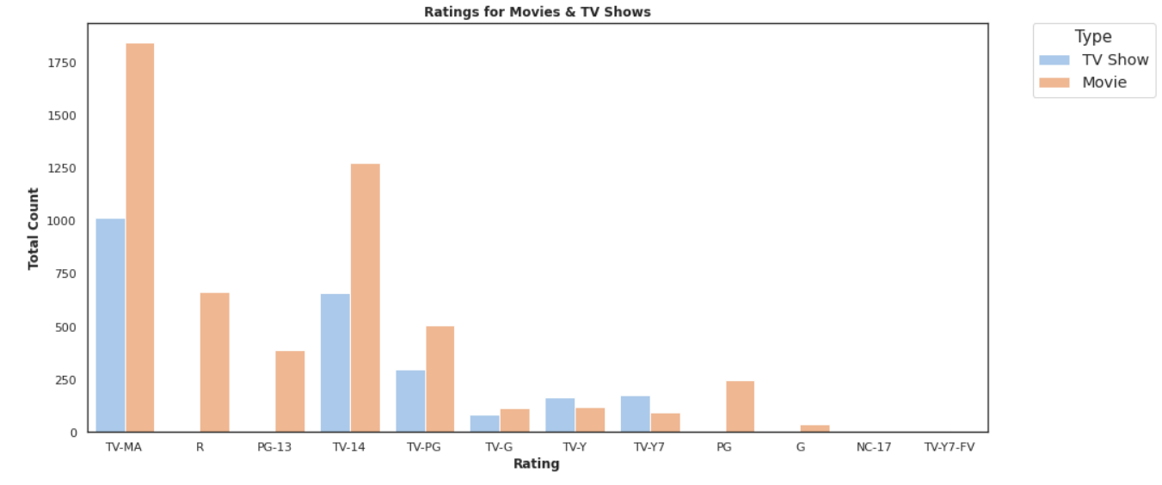
Ratings for Movies & TV Shows
The largest count of Movies and TV shows is made with a "TV-MA" rating. "TV-MA" is a rating assigned by the TV Parental Guidelines to a television program that was designed for mature audiences only.

Slide 18
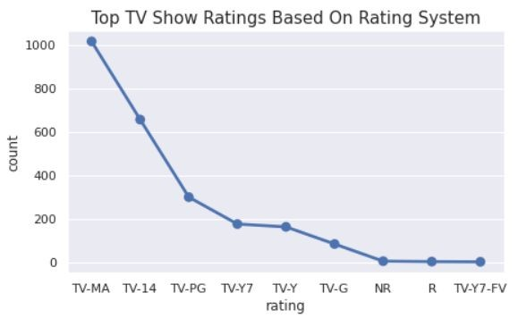
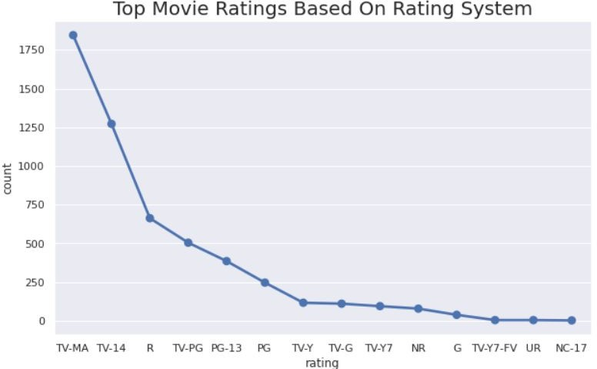
TOP Content Based On Rating
Most of the contents got ratings like
TV-MA ( For Mature Audiences)
TV-14 ( May be unsuitable for children under 14)
TV-PG ( Parental Guidance Suggested )
NR ( Not Rated )

Slide 19
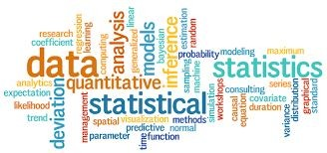
Word Cloud
What Is a Word Cloud?
A word cloud (also known as a tag cloud) is a visual representation of words. Cloud
creators are used to highlight popular words and phrases based on frequency and relevance. They provide you with quick and simple visual insights that can lead to more in-depth analyses.
De
Example →

Slide 20
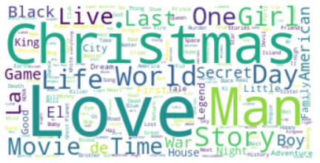

Applying WordCloud on Title
Most occurred words present in Title are:-
Love
Man
World
Story
Christmas
Girl
Day
Why Christmas occurred ?

Slide 21
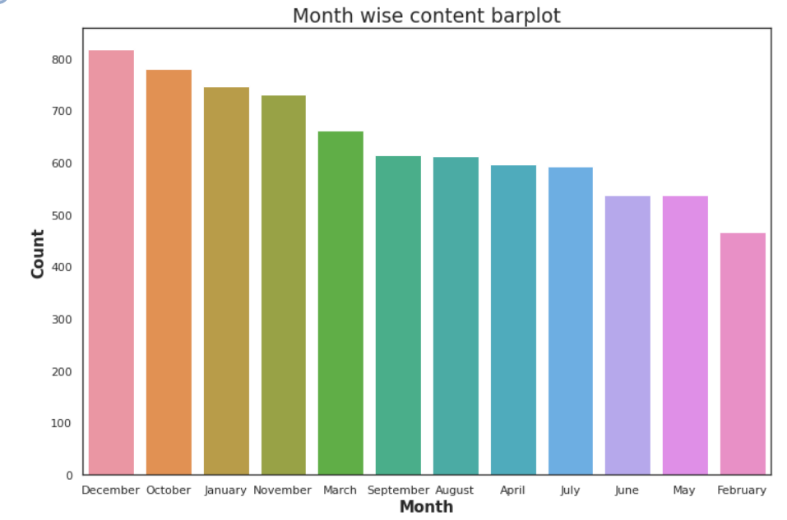
Barplot based on release month
We can say that December is the holiday season and it also has Christmas, so in that month most of the content got uploaded.

Slide 22
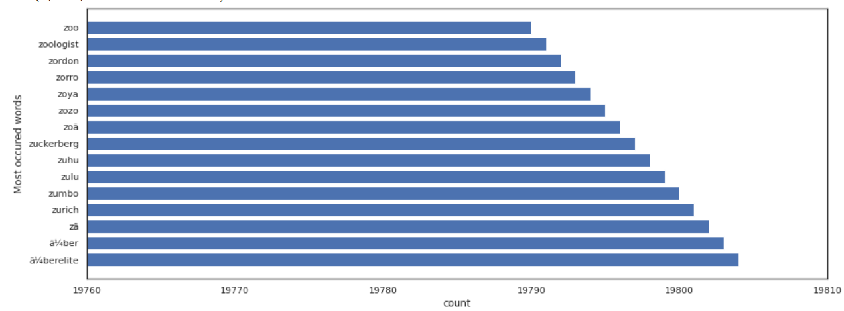
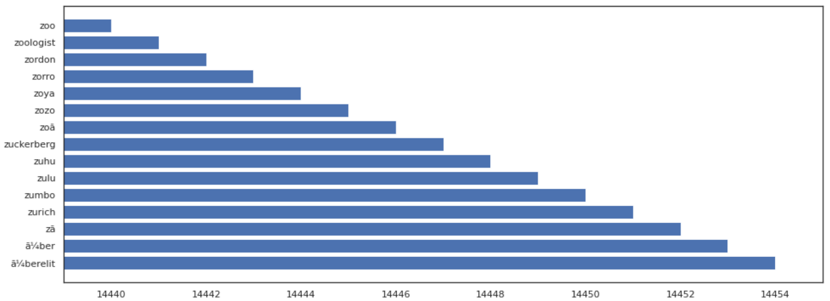
Before & After Stemming most occurred words
in description
Before stemming its ranges between 19700-19800 and after stemming its reduced to 14455.
so basically Stemming is a technique used to extract the base form of the words by removing affixes from them. It is just like cutting down the branches of a tree to its stems.

Slide 23
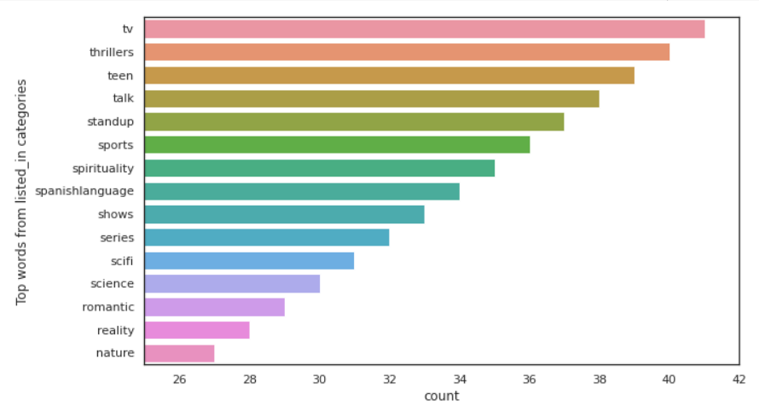
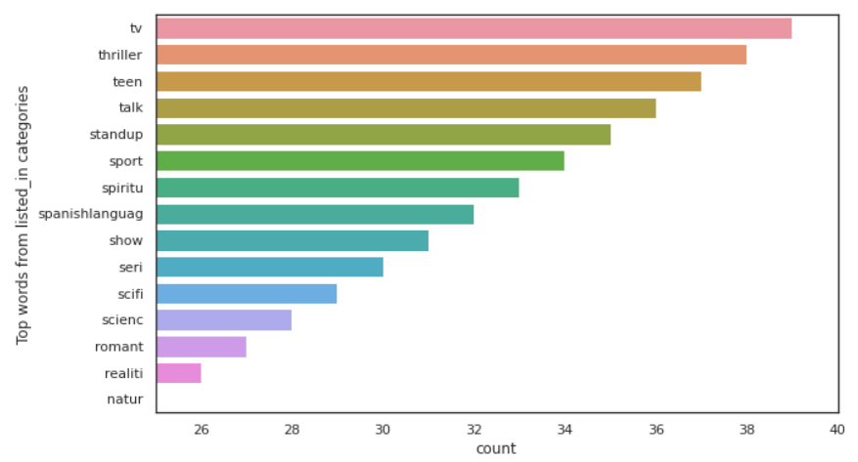
Before & After Stemming most occurred words
in listed_in
All the inflected words has removed after applying stemming technique.

Slide 24
Feature Selection & ML algo used
Only selected 3 features , to do CLUSTERING
no_of_category
Length(description)
Length(listed-in)
Using STANDARDSCALER
Using K-Means model
Used 4 ALGORITHM to find out best k value
Silhouette score
Elbow Method
Dendrogram
Agglomerative Clustering

Slide 25
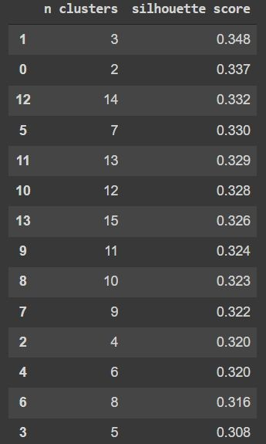

1. Silhouette Score
Silhouette Coefﬁcient Formula
mean intra-cluster distance(a):- Mean distance between the observation and all other data points in the same cluster.
mean nearest-cluster distance (b)
:- Mean distance between
the observation and all other data points of the next nearest cluster. This distance can also be called a.
The value of the silhouette coefﬁcient is between [-1, 1]
If score is 1 denotes the best meaning that the data point i is very compact within the cluster to which it belongs and far away from the other clusters.
The worst value is -1
If score is 0 denotes overlapping clusters

Slide 26
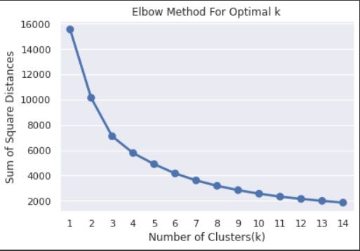
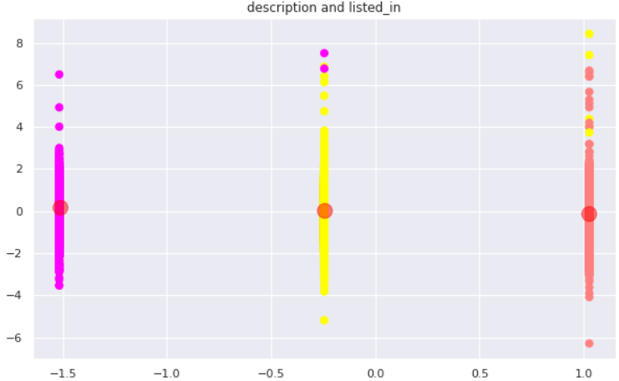
2. Elbow Method
The elbow method runs k-means clustering on the dataset for a range of values for k (say from 1-15) and then for each value of k computes WCSS value . By default, the distortion score is computed, the sum of square distances from each point to its assigned center.

Slide 27
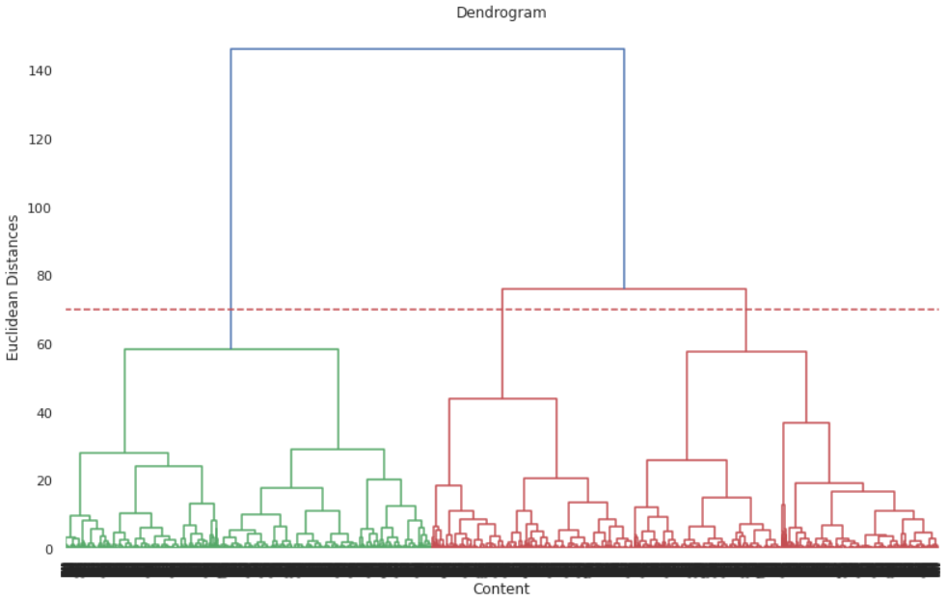
3 Dendrogram
As we can see in the dendrogram that horizontal line is cutting 3 vertical lines so, the number of clusters we will choose is 3.

Slide 28
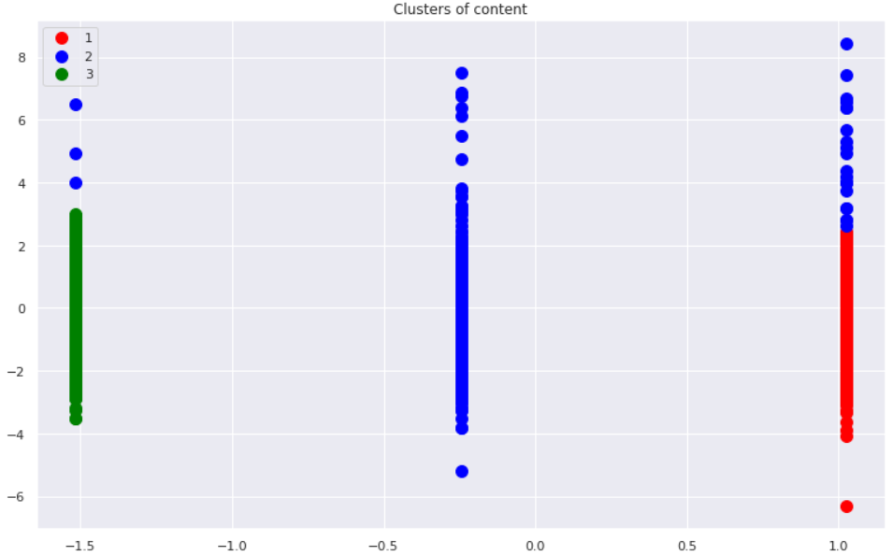
4. AgglomerativeClustering
Steps: -
Each data point is assigned as a single cluster.
Determine the distance measurement and calculate the distance matrix.
Determine the linkage criteria to merge the clusters.
Update the distance matrix.
Repeat the process until every data point become one cluster.

Slide 29
Conclusion
Director and cast contains a large number of null values so we will drop these 2 columns .
In this dataset there are two types of contents where 30.86% includes TV shows and the remaining 69.14% carries Movies.
We have reached a conclusion from our analysis from the content added over years that Netﬂix is focusing movies and TV shows (Fom 2016 data we get to know that Movies is increased by 80% and TV shows is increased by 73% compare)
From the dataset insights we can conclude that the most number of TV Shows released in 2017 and for Movies it is 2020.
On Netﬂix USA has the largest number of contents. And most of the countries preferred to produce movies more than TV shows.
TOP 3 content categories are International movies , dramas , comedies.
The largest count of Netflix content is made with a “TV-MA” rating.
In text analysis (NLP) I used stop words, removed punctuations , stemming & TF-IDF vectorizer and other functions of NLP.
Applied different clustering models like Kmeans, hierarchical, Agglomerative clustering, DBSCAN on data we got the best cluster arrangements.
By applying different clustering algorithms to our dataset we get the optimal number of cluster is equal to 3.

Slide 30
Conclusion Continue.
It's clear that Netflix has grown over the years. We can see it from the data that the company took certain approaches in their marketing strategy to break into new markets around the world.
Based on an article from Business Insider, Netflix had about 158 million subscribers worldwide with 60 million from the US and almost 98 million internationally. Netflix's original subscriber base was based solely in the United States following its IPO.
International Movies is a genre that is mostly in Netflix.
A large part of its success was due to the decision to expand to international markets. The popular markets prioritizes what content the company will release. In this case, we can see that a good amount of international movies and TV shows were added over the years as part of Netflix's global expansion.

Slide 31


